Slide 1
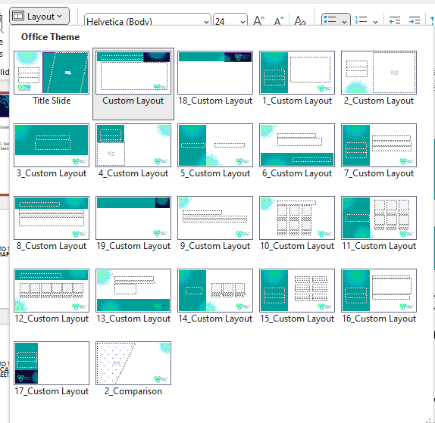
HOW TO USE THIS TEMPLATE
SELECT YOUR COVER SLIDE
Let the GEO Team know if a design for your city is missing from the pack
KEEP THE GEO INTRODUCTION AND EVENT UPDATE SLIDES
Each meeting should feature an introduction to GEO, benefits of joining as a member and details of future events for all newcomers
ADD YOUR CONTENT
Use the slide templates in the Layout feature in the top menu to build your presentation deck
CONTACT THE GEO TEAM WITH ANY QUESTIONS
We’re here to support you with any questions and to provide the marketing support
you need to ensure a successful event!
THANK YOU FOR SUPPORTING GEO!

Slide 2
WELCOME TO THE BOSTON CHAPTER MEETING

Slide 3
WELCOME TO THE NORTHERN CALIFORNIA CHAPTER MEETING

Slide 4
WELCOME TO THE GREATER CHINA CHAPTER MEETING

Slide 5
WELCOME TO THE DACH CHAPTER MEETING

Slide 6
WELCOME TO THE FRANCE CHAPTER MEETING

Slide 7
WELCOME TO THE INDIA CHAPTER MEETING

Slide 8
WELCOME TO THE ISRAEL CHAPTER MEETING

Slide 9
WELCOME TO THE MELBOURNE CHAPTER MEETING

Slide 10
WELCOME TO THE NEW YORK CHAPTER MEETING

Slide 11
WELCOME TO THE SWISS ROMANDIE CHAPTER MEETING

Slide 12
WELCOME TO THE SYDNEY CHAPTER MEETING

Slide 13
WELCOME TO THE TORONTO CHAPTER MEETING

Slide 14
WELCOME TO THE UK AND CHANNEL ISLANDS CHAPTER MEETING

Slide 15
WELCOME TO THE TEXAS CHAPTER MEETING

Slide 16
WHAT MAKES
GEO
SPECIAL?
IN NUMBERS
COMMUNITY
RESOURCES
Ever-evolving member driven resources that meet your professional and personal development needs.
Expert, cost-effective industry resources
+5k
individual members across the globe connected by GEO
Partner with global, reputable and world-class peers and suppliers, when and where it suits you.
A network of trusted industry partners
GEO IS THE LEADING NON-PROFIT GLOBAL SHARE OWNERSHIP COMMUNITY
+60
Member countries accessing GEO’s
events and resources
We are focused on promoting share ownership for the benefit of employees, companies and communities
SIMPLICITY
RECOGNITION
+3
Global share plan industry individual and corporate recognition programs
Access the information, people or resources you need quickly and easily, in a place that works for you.
Instant, easy 24/7 access
Reward and recognition programmes for individuals and companies.
Elevating the industry’s best
+25
years of serving the global share plan industry

Slide 17
CLICK TO PLAY BRAND VIDEO
OUR NEW BRAND

Slide 18
WHY JOIN GEO?
GEO IS YOUR PARTNER IN ELEVATING YOUR EMPLOYEE AND EXECUTIVE SHARE PLANS AND ACHIEVING YOUR CAREER AMBITIONS.
GEO provides the tools and solutions to take
action today and make a world of difference
With employee share ownership.
WE MAKE IT EASY TO ACCESS THE RIGHT PEOPLE AND INFORMATION
Global share plan and executive compensation education
Plan strategy and design
Global and multi-national best practices and benchmarking
The latest survey data, trends, innovations, and recommendations
Strong global network of equity and executive compensation leaders, decision makers, innovators, academics, experts and professionals

Slide 19
SHAPING THE FUTURE OF
SHARE OWNERSHIP
Read industry news, explore technical updates, access ideas on global employee compensation innovation, and find ways to connect.
Surveys and reports
Articles and insights
News and updates
Stay ahead through ever-evolving member driven resources that meet your professional and personal development needs.
Online learning resources
Courses
On-demand webcasts
Learn from and develop relationships with other issuers and providers around the world and in your local region.
Member directory
Online chapter resources
Discussions, blogs and articles
DATA AND INSIGHTS
LEARNING AND DEVELOPMENT
GLOBAL COMMUNITIES

Slide 20
RECEIVE THE RECOGNITION YOU DESERVE
CELEBRATING THE GLOBAL SHARE PLAN INDUSTRY’S BEST AND BRIGHTEST SINCE 2002
OUR FELLOWS ARE SELECTED FOR THEIR CONTRIBUTIONS TO THE GLOBAL EQUITY INDUSTRY
A DEVELOPMENT AND THOUGHT LEADERSHIP PROGRAM FOR EMERGING PRACTITIONERS
Individual and corporate awards across 10 categories
Take part in GEO’s Excellence in Global Share Plans thought leadership program
Apply October to January
Winners announced at GEO’s annual conference each April
Fellow Global Equity (FGE) designation
Access to Fellows events
Discounts for GEO events
Lifetime membership to GEO post-retirement
Apply year round, selections on 31 January, 30 June and 31 October
Two-year individual GEO membership with full GEOLearn access
Free registration and speaker slot at GEO Austin 2026
Free access to regional chapter and virtual events
Peer networking and participation in a thought-leadership project
Apply year round, selections 1 August

Slide 21
UPCOMING EVENTS
Globally-based local Chapter events
Check our website for details
Join our 26th Annual Conference
Prague: 28 - 30 April 2025
GEO Awards at Žofín Palace Prague: 29 April 2025
INDUSTRYLEADER
EMERGINGLEADER
An introductory course for emerging equity professionals
Virtual: 6, 8,13 and 15 May 2025
Apply to become a GEO Fellow
30 June 2025
Apply to become a Future Leader
1 August 2025
2025 Regional Events
18 September - NorCal Forum, San Mateo November - London, UK
December – East Coast, Boston
Visit the GEO website for webcasts, event information and to register >>> globalequity.org/event-calendar

Slide 22
GEO’s 24TH EDINBURGH CONFERENCE 2023
JOIN US AT OUR 24TH ANNUAL CONFERENCE
REGISTRATION IS OPEN! VISIT GLOBALEQUITY.ORG/EVENTS/PRAGUE-2025

Slide 24
Add your content slides from this point forward

Slide 25
THANK YOU FOR ATTENDING

